Slide 1
UBC Designathon 2022 SEMI-TECHNICAL DRONE
Team 11 – Willem’s Angels: Willem Van Dam - Graeme Dockrill - Owen Byrne - Idil Bil

Slide 2
Table of Contents
1. Our Design
2. Problem Breakdown
3. Motor and Battery Selection
5. Main Body
6. Frame Simulations
4. Food Box
7. Emergency Landing

Slide 3
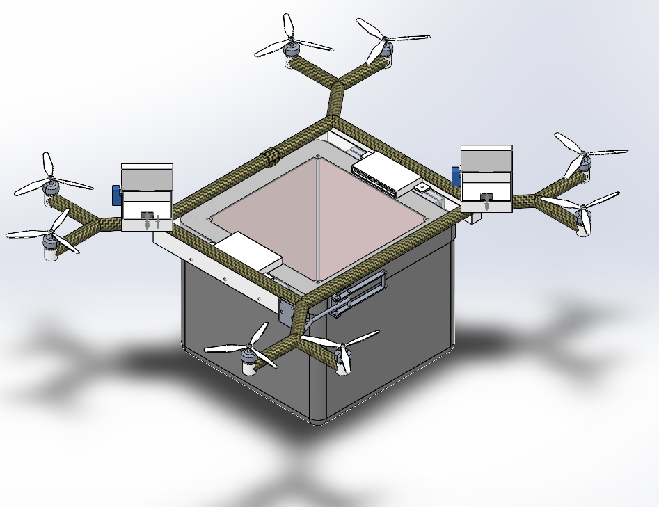
Our Design

Slide 4
1.
Problem Breakdown
Propeller and Battery Selection
3.
Main Body
2.
Food Box
Emergency Landing Feature
4.

Slide 5
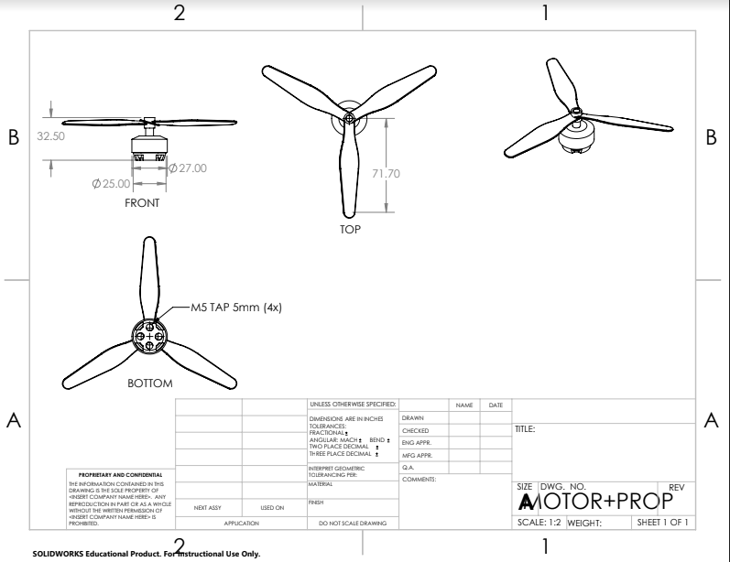
Propeller and Battery Selection
To ensure our drone can perform the required tasks, we needed to specify the number/type of the motors and batteries
Using the provided spreadsheet, we optimized for weight and flight time

Slide 6
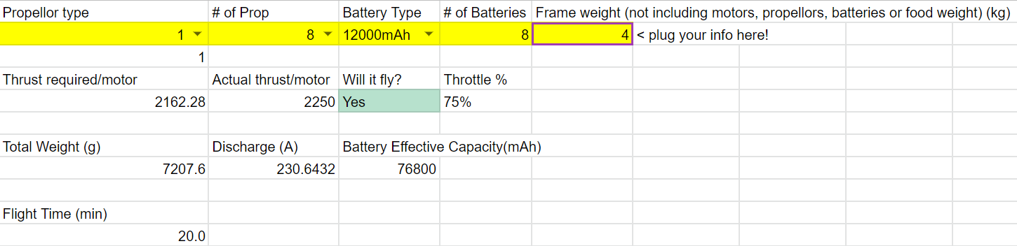
Propeller and Battery Selection
We chose 8 of the first type of propeller and 8 of the 12000 mAh batteries.
This allows us to carry 7.2 kg of weight for the required 20 minutes.

Slide 7
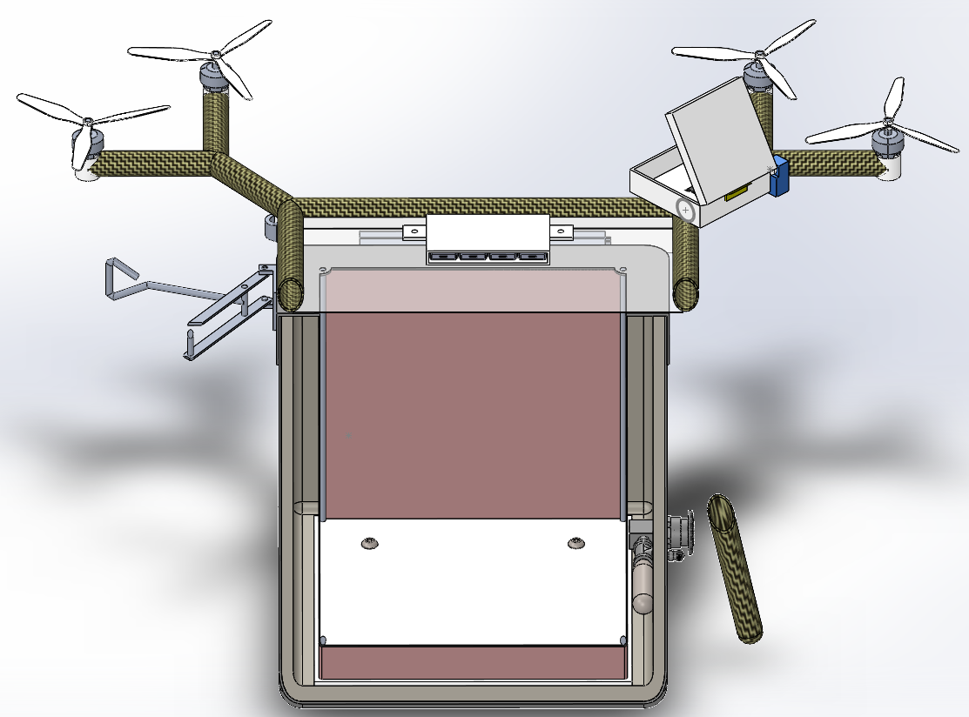
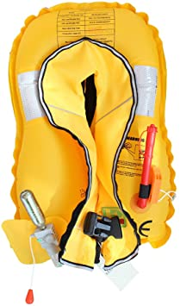
Food Box
Once food is placed inside operator will press the air release button until the food is held in place by the expanding rubber walls.
Air tank refilled during charging by compressed air

Slide 8
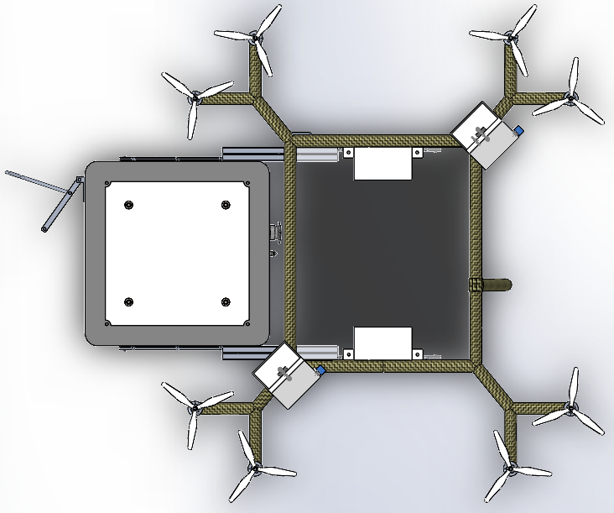
Food Box
After arrival ABS food tray will be pulled out by lifting latch and the air inside will be released out of the back.
Recipient will take their food, close the door to the drone and the device will return to the charging station.

Slide 9
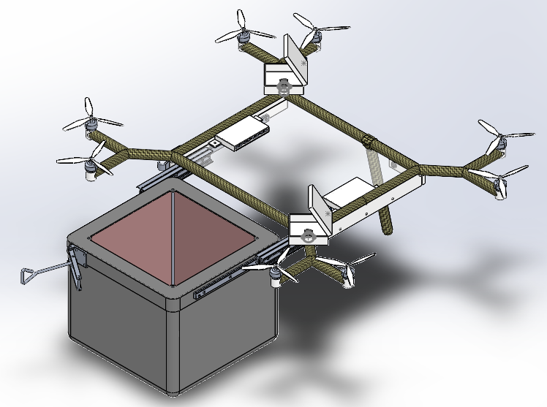
Main Body
The main body needs to hold the entire drone together
Carbon fibre rods as the main frame
Rails attached to main body to slide food box out
Leg at rear prevents tipping when box opened
Clear window to see inside

Slide 10
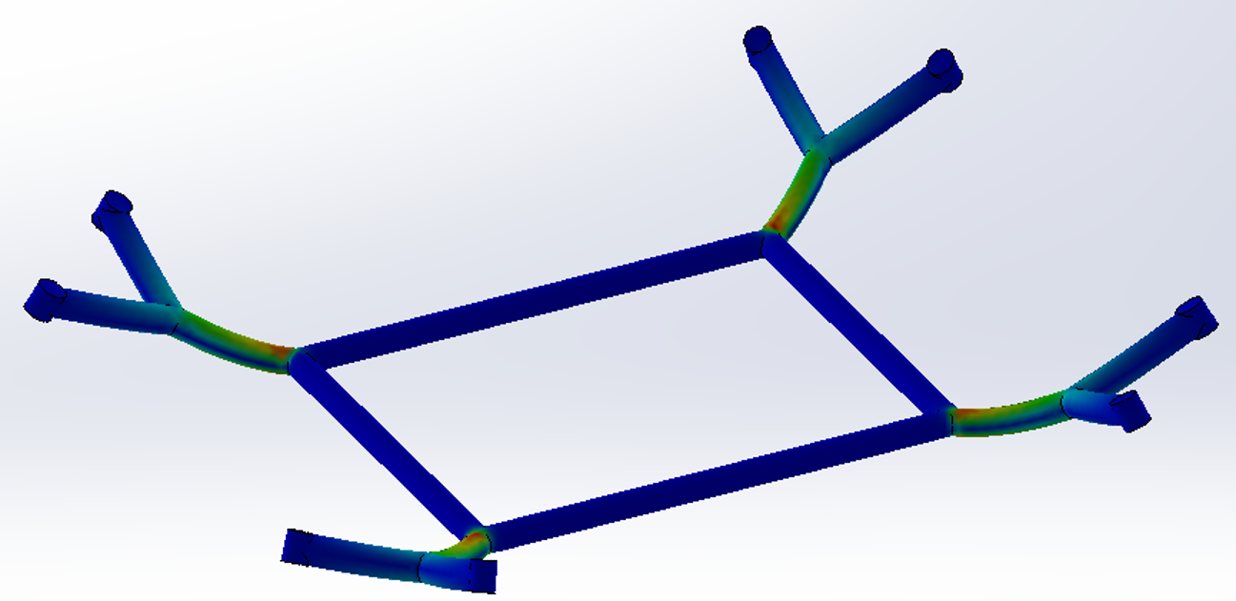
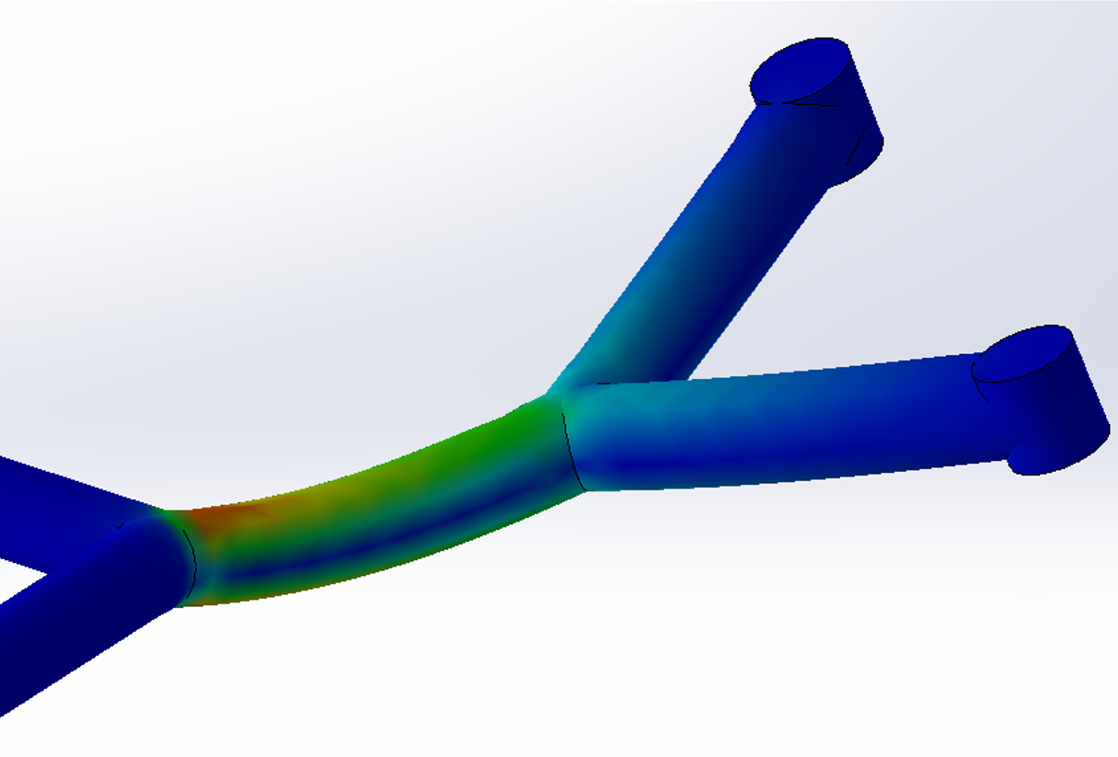
Frame Simulations
We conducted a static stress analysis on the upper frame and determined the stress to be far below our yield stress.

Slide 11
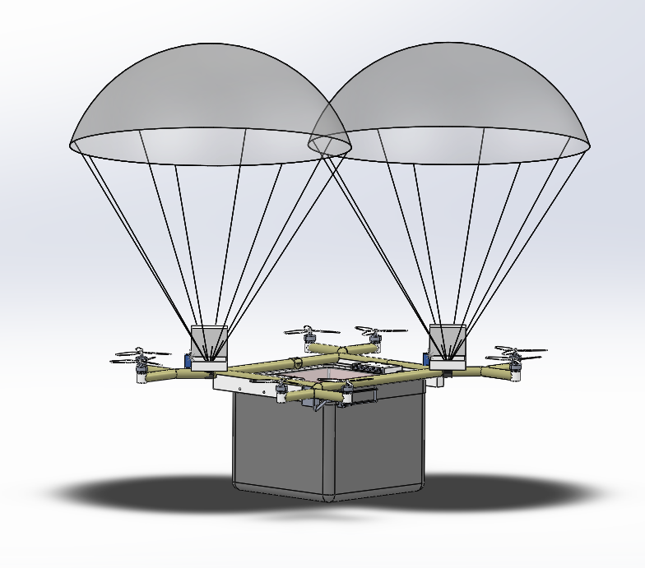
Emergency Landing Feature
An important part of the design is planning for the event of equipment failure.
In the event of failure, the drone needs to survive a fall.

Slide 12
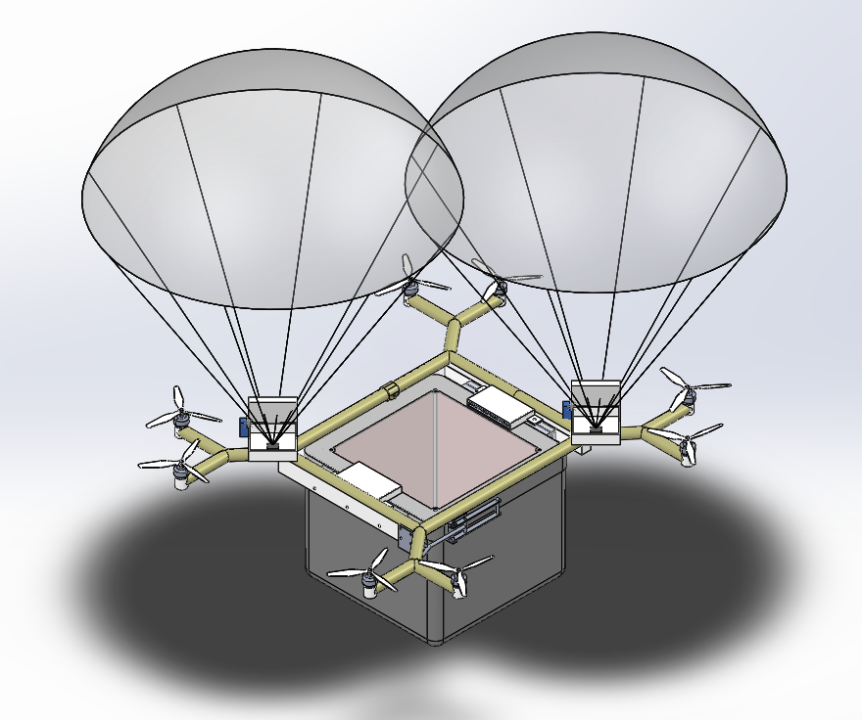
Emergency Landing Feature
After an acceleration similar to free fall is detected, the servo motor will actuate and release the parachute.
The drone will then safely lower to the ground.

Slide 13
Thank you for listening!
Do you have any questions?

Slide 14
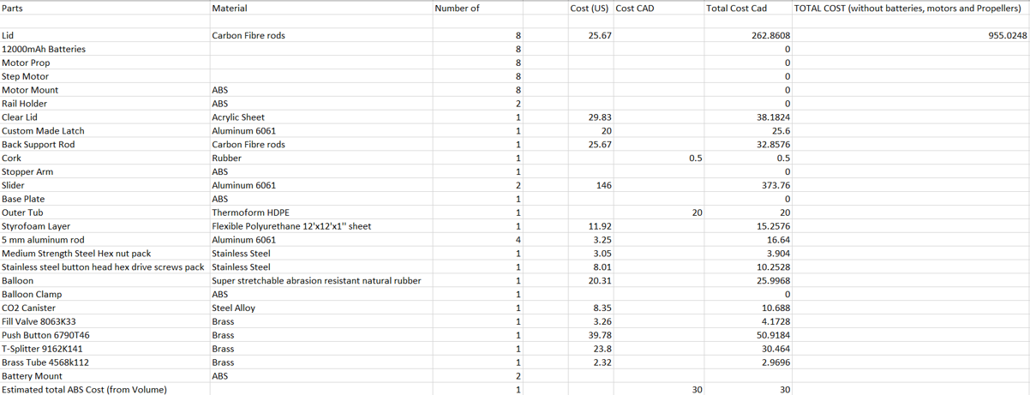
Appendix A – Bill of Materials

Slide 15
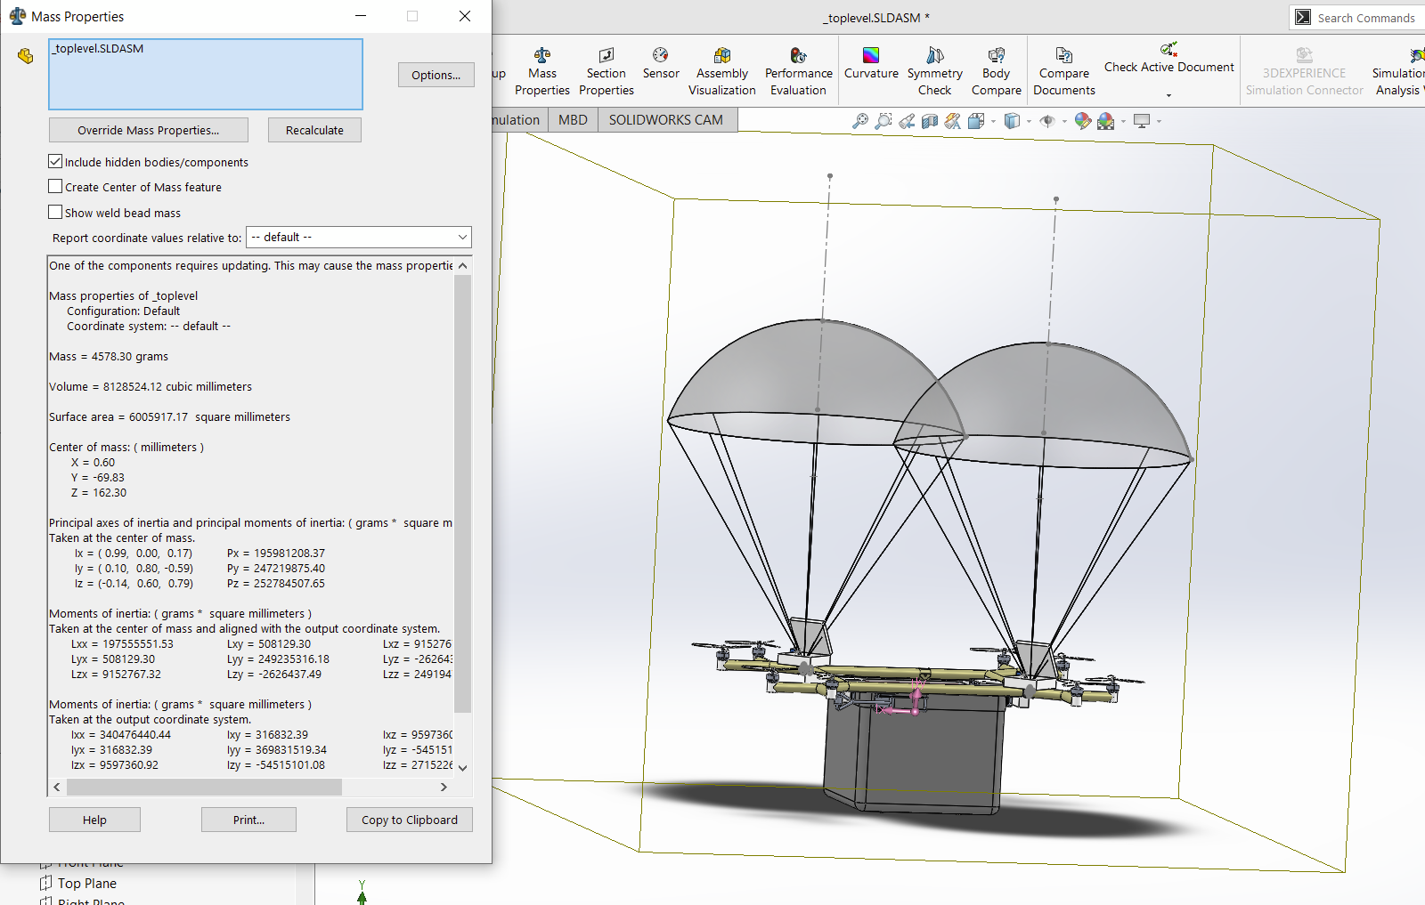
Appendix B – Mass Analysis

Slide 16
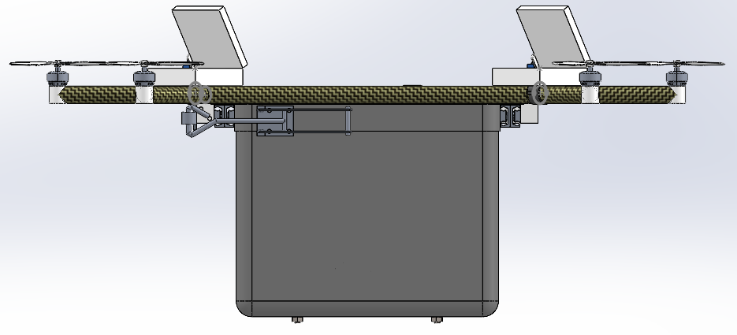
Appendix C – Additional Photos

Slide 17
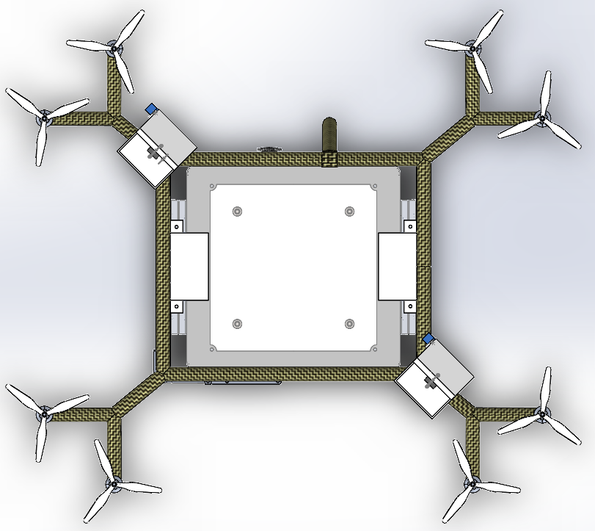
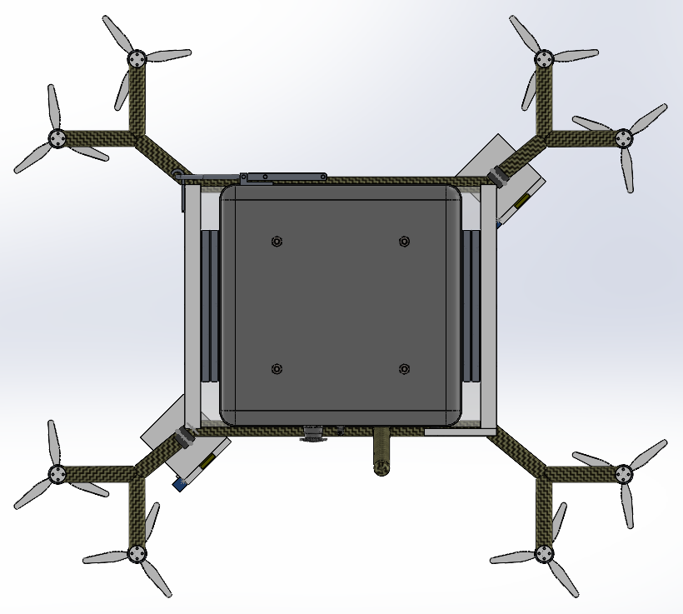
Appendix C – Additional Photos

Slide 18
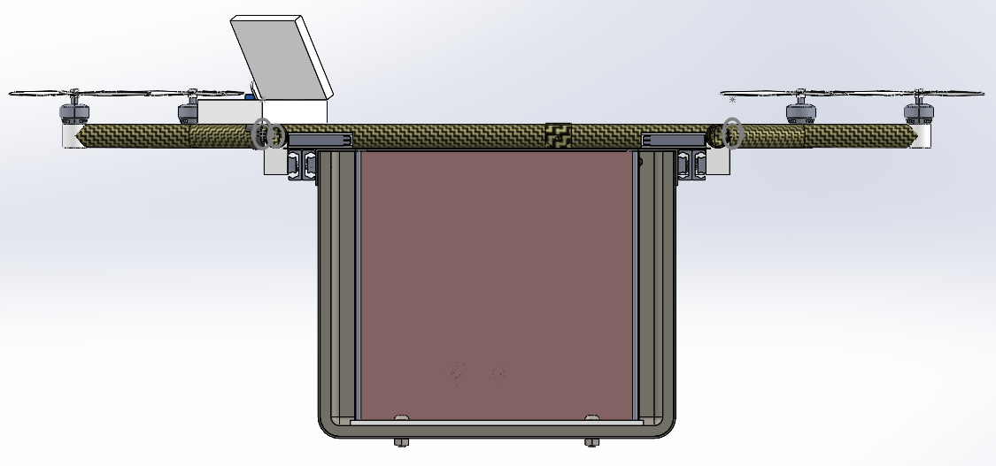
Appendix C – Additional Photos

Slide 19
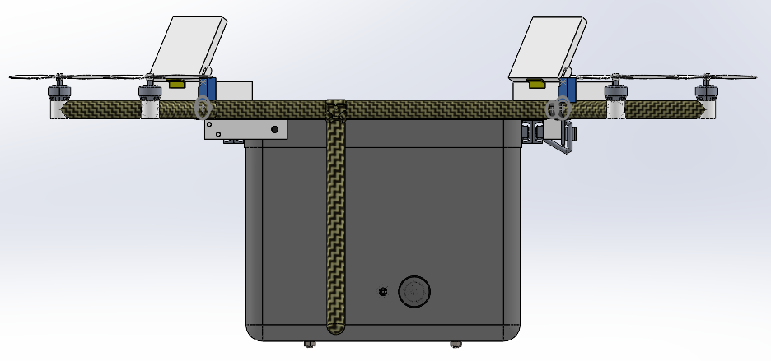
Appendix C – Additional Photos

